Slide 1
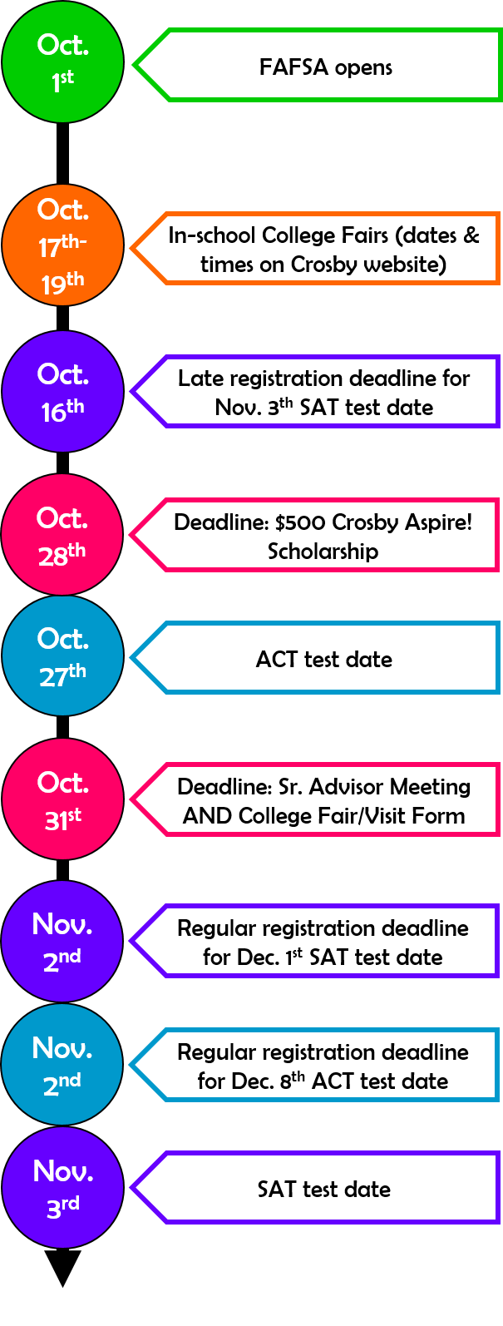
Senior Program – Class of 2019
Timelines for Success
OCTOBER
College Admissions:
Taking the November 3rd SAT? Sign up by October 16th
Taking the December 8th ACT? Sign up by November 2nd
If you’re planning to pursue a technical degree or certificate program, continue to explore options and requirements
Visit your top choice schools – note special visitation days
Update your activities resume
Put deadlines (early action/decision and regular), due dates, and test dates in your calendar
Identify documents you still need to complete your applications
Continue to write and edit your application essays – submit your essays to Crosby Scholars for feedback
Ask teachers, school guidance counselor, coaches, employers, etc. for letters of recommendation, if required
Submit test scores and transcripts to schools on your target list
Financial Aid:
Apply for the $500 Crosby Scholars Aspire! Video Contest Scholarship (see your Crosby Scholars portal for information)
Review your high school’s scholarship bulletin, and apply for scholarships
Complete and submit your FAFSA
Complete your North Carolina Residency Determination
Crosby Scholars:
Attend your school’s college fair if you still need to meet the College Fair/College Visit requirement (due October 31st)
Meet with your Senior Advisor to complete your October Conference notes by October 31st
Read the October edition of DestinationCollege2019
Complete 2 hours of community service and submit your form
Check email and student portal at least weekly
Register for and attend Crosby Senior Academies online through your Crosby portal

