Slide 1
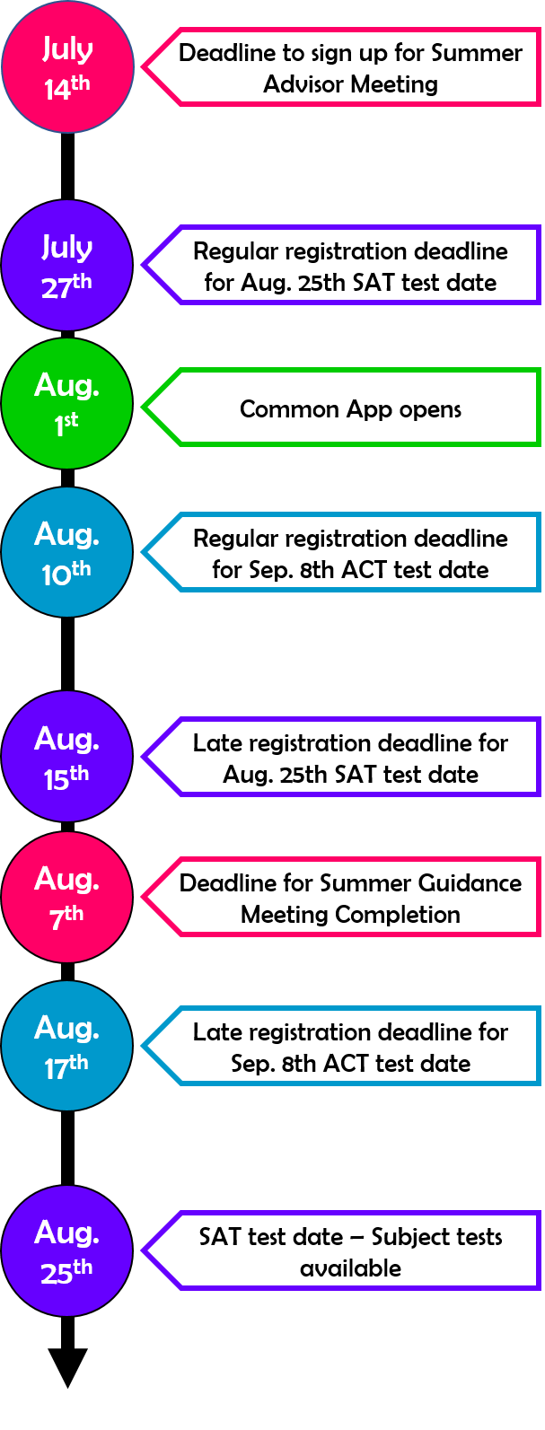
Timelines for Success
JULY
College Admissions:
Sign up for your Summer Advisor Meeting by July 14th
Taking the August 25th SAT? Sign up by July 27^{th.}
Taking the September 8th ACT? Sign up by August 10th
Confirm test dates and registration deadlines for the fall SAT and/or ACT
Review career plans and decide which type of school is right for you (4-year, 2-year, etc.)
Research and confirm your target list of colleges
Follow prospective colleges on social media
Continue to visit colleges on your target list -- note special visitation days
Put deadlines, due dates, and test dates in your calendar
Create accounts for the Common App, CFNC and/or the Coalition App, depending on which one(s) you plan to use
Brainstorm ideas for application essays
Consider the possibility of taking a Gap Year
Financial Aid:
Research and apply for scholarships
Create your FSA ID
Complete your North Carolina Residency Determination
Crosby Scholars:
Read the July edition of DestinationCollege2019
Sign up for text reminders--text @csisr2019 to 81010
Complete 2 hours of community service and submit your form to our office
Check email and student portal at least weekly
Register for and attend Crosby Senior Academies online through your Crosby portal

